Slide 1
Thyroid-SPOT
Name: Yu KaiLong
Matrix: 1801188B
Supervisor: Ms Fua Ying Huey

Slide 2
Background
An application to effectively manage hyperthyroidism and hypothyroidism treatment using personalized medical algorithm.
Clinicians
Effectively determine drug doses
Better management of patients
Patients
Track Medical History
Learn more about their disease

Slide 3
Targeted Users
Clinicians
Patients suffering from thyroid diseases

Slide 4
Features
Adding patients under the clinician
Transferring of patients
Removing of patients
Sorting of patients
Search for patients
Graph with algorithm built in
Adding / Editing / Deleting of health report
Adding / Editing / Deleting of prescription
Notifications for the patient

Slide 5
Existing Products
There was a previous built, however it was old, and not compatible with modern devices.
Patient’s information were not connected to database
Not user-friendly
Lacks of information on the disease
Only has mobile version

Slide 6
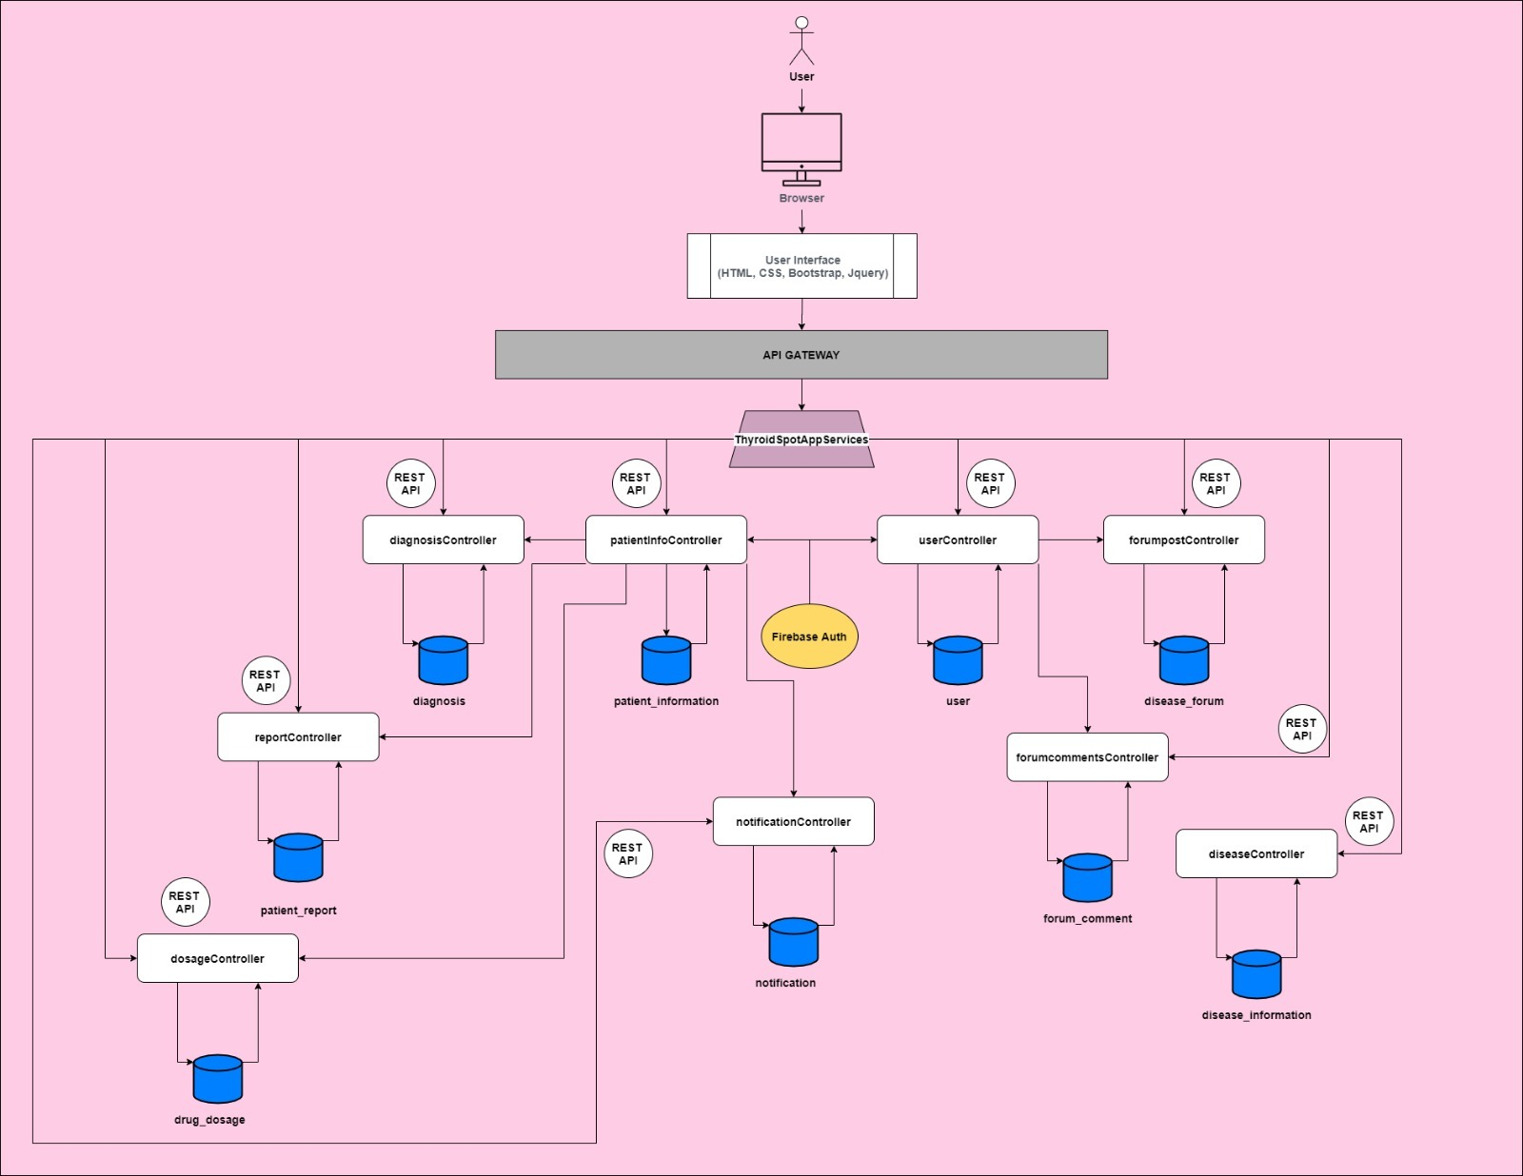
System Architecture

Slide 7
Assumptions
All users know English
Assume that users would know how each functions works.

Slide 8
User Guide
DEMO

Slide 9
Limitations
No changing of languages
The web app has an inbuilt notification which means that patients will only see the notifications when they log in.

Slide 10
Future Enhancement
Adding of email notification
Adding of different languages
Adding of notification function for the clinician

Slide 11
Challenges / Lessons Learnt
Graph – as there was not much resources online / don’t understand. Therefore I spent quite a lot of time working on the graph.
Spending too much time on the graph made me lose quite a lot of precious time which I could be spending on doing additional functions

Slide 12
Thank You

